Slide 1
Dropping Triggers, Removing Triggers Form The Databases When They Are No Longer Needed

Slide 2
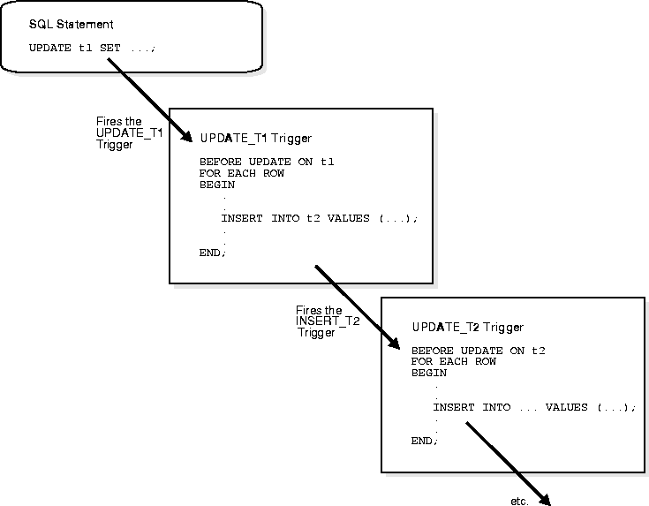
Introduction
Triggers in databases are used to automate actions based on specified conditions.
Dropping triggers is important to maintain database performance and efficiency.
Removing unnecessary triggers can prevent unintended actions and save resources.
Notes:
Image source: https://www.sdcc.bnl.gov/phobos/detectors/computing/orant/doc/database.804/a58227/ch15.htm

Slide 3
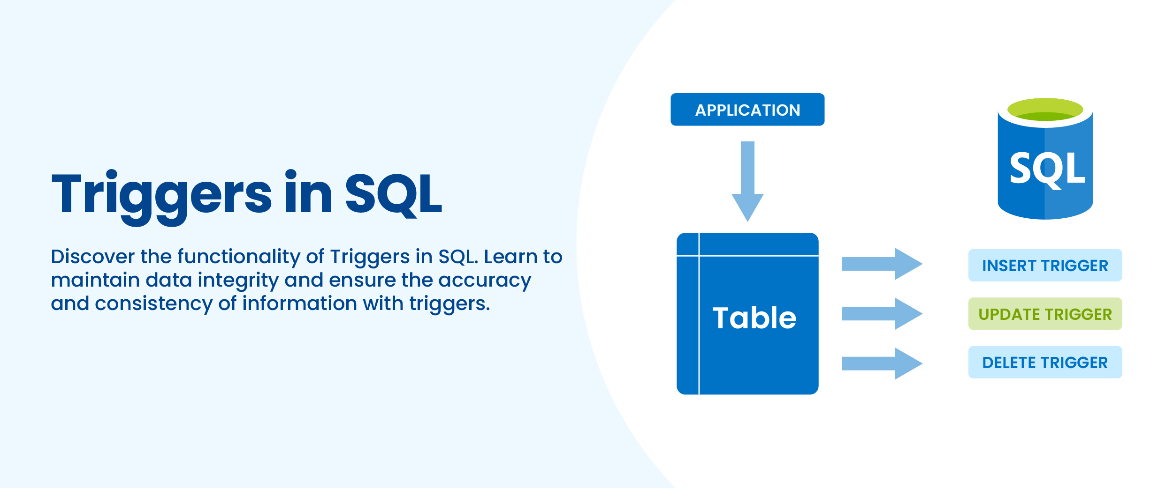
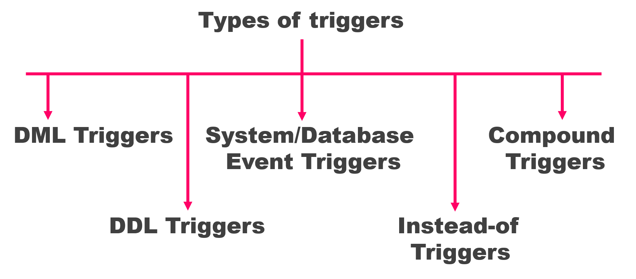
Understanding Triggers
Triggers are database objects that are activated in response to certain events.
They can be classified into different types such as DML triggers, DDL triggers, and system triggers.
Triggers are commonly used for enforcing data integrity, auditing changes, and automating tasks.
Notes:
Image source: https://www.rebellionrider.com/what-are-database-triggers/

Slide 4
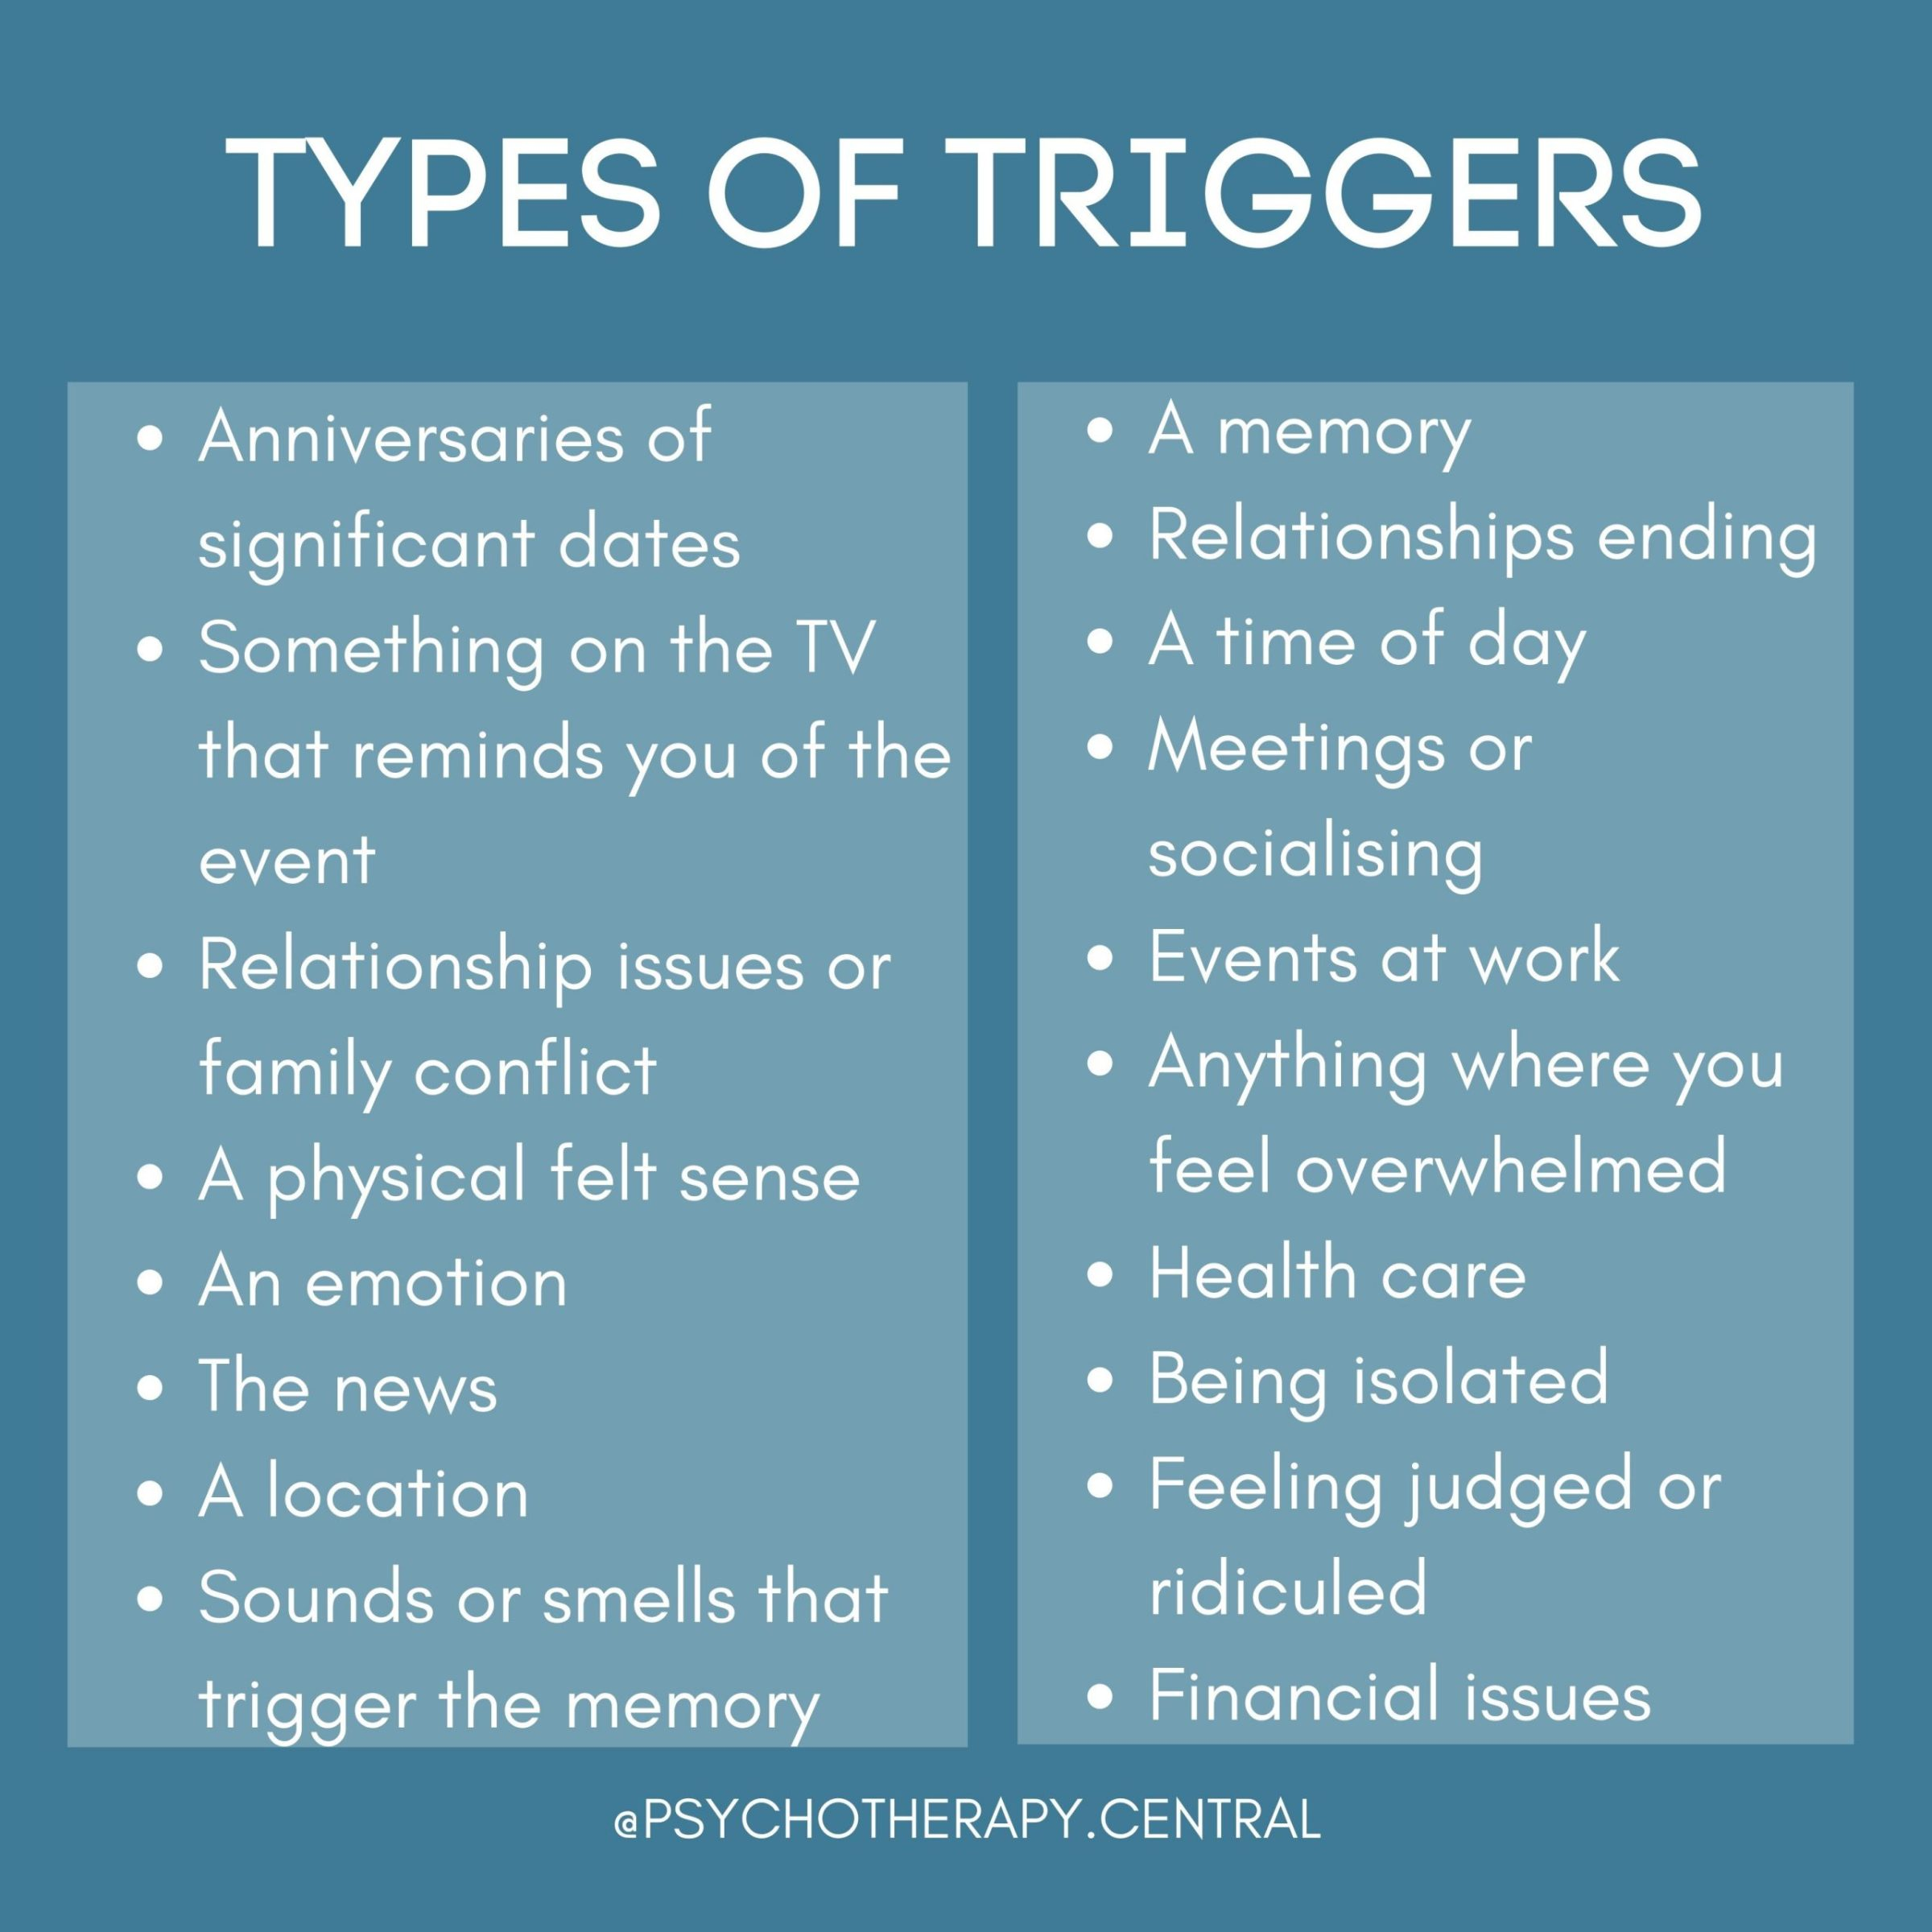
Reasons for Dropping Triggers
Triggers may become obsolete due to changes in business requirements.
Redundant triggers can impact database performance and slow down operations.
Removing unnecessary triggers can simplify database maintenance and troubleshooting.
Notes:
Image source: https://jennynurick.com/types-of-triggers/

Slide 5
Dropping or removing triggers from a database when they’re no longer needed is an essential part of database maintenance. Triggers are often used to enforce business rules, maintain data integrity, or automate certain tasks when specific events occur in a database. However, they can accumulate over time and might become obsolete due to changes in business requirements or application logic. Here’s a general guideline for dropping triggers: Identify Unused Triggers: Regularly review the triggers in your database to identify those that are no longer necessary. This can be done manually or through automated scripts that analyze trigger usage. Review Business Requirements: Understand the current business requirements and application logic to determine if any triggers are no longer needed due to changes in functionality or workflows. Test Before Removal: Before removing any triggers, make sure to thoroughly test your database and applications to ensure that removing the triggers won’t cause any unintended consequences or break existing functionality

Slide 6
Drop Triggers: Once you’ve identified and confirmed that a trigger is no longer needed, use the appropriate SQL command to drop it from the database. In most database management systems, the syntax for dropping a trigger is straightforward, such as DROP TRIGGER trigger_name;. Document Changes: Keep detailed documentation of the triggers that are dropped, along with the reasons for their removal. This documentation can be valuable for future reference and auditing purposes. Monitor Performance: After removing triggers, monitor the performance of your database and applications to ensure that there are no adverse effects. Sometimes, dropping unused triggers can improve database performance. Regular Maintenance: Make dropping unused triggers a part of your regular database maintenance routine to keep your database clean and optimized over time.

Slide 7
Best Practices for Dropping Triggers
Review and document all existing triggers before deciding to drop them.
Test the impact of removing triggers in a non-production environment.
Communicate with stakeholders and obtain approval before dropping critical triggers.
Notes:
Image source: https://jennynurick.com/types-of-triggers/

Slide 8
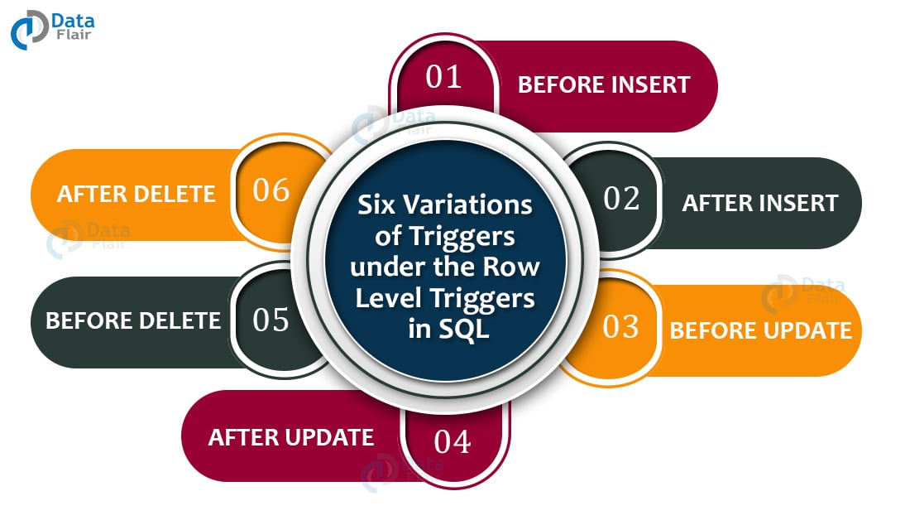
Dropping Triggers in SQL
To drop a trigger in SQL, use the DROP TRIGGER statement followed by the trigger name.
Make sure to specify the schema name along with the trigger name if it's not in the default schema.
Dropping a trigger requires appropriate permissions on the database object.
Notes:
Image source: https://data-flair.training/blogs/triggers-in-sql/

Slide 9
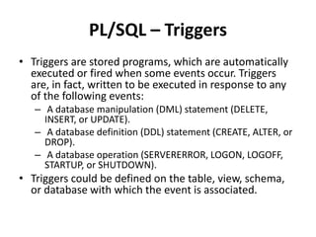
Impact of Dropping Triggers
Dropping a trigger can affect the behavior of applications relying on it.
It's important to analyze the consequences of dropping a trigger on related database objects.
Consider alternative solutions or modifications before removing a trigger completely.
Notes:
Image source: https://jennynurick.com/types-of-triggers/

Slide 10
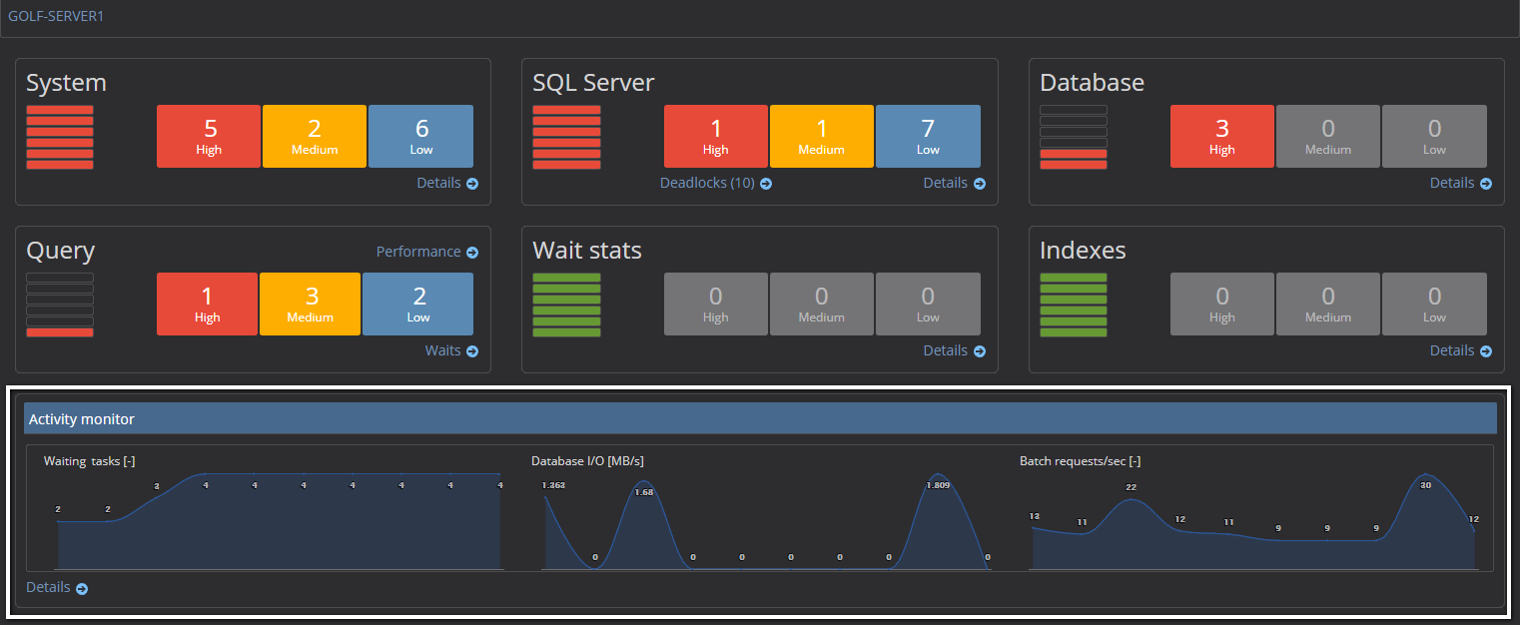
Monitoring Trigger Activity
Regularly review the usage and performance of triggers in the database.
Implement logging and monitoring mechanisms to track trigger executions.
Identify and address any issues or bottlenecks caused by triggers proactively.
Notes:
Image source: https://knowledgebase.apexsql.com/how-to-use-and-interpret-the-sql-server-activity-monitor/

Slide 11
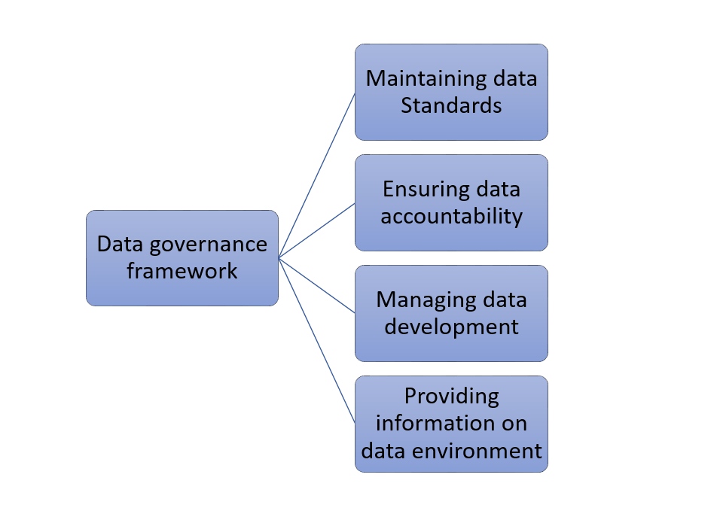
Conclusion
Dropping triggers when they are no longer needed is essential for maintaining a healthy database environment.
Proper planning, testing, and communication are key aspects of removing triggers safely.
Regularly evaluate the necessity of triggers to optimize database performance and streamline operations.
Notes:
Image source: https://vitalflux.com/data-governance-framework-template-example/

